Slide 1

Chapter 6
Bandwidth Utilization:
Multiplexing
6.<number>
Copyright © The McGraw-Hill Companies, Inc. Permission required for reproduction or display.

Slide 2

Note
Bandwidth utilization is the wise use of
available bandwidth to achieve
specific goals.
Efficiency can be achieved by multiplexing.
6.<number>

Slide 3
6-1 MULTIPLEXING
Whenever the bandwidth of a medium linking two devices is greater than the bandwidth needs of the devices, the link can be shared. Multiplexing is the set of techniques that allows the simultaneous transmission of multiple signals across a single data link. As data and telecommunications use increases, so does traffic.
Topics discussed in this section:
Frequency-Division Multiplexing
Wavelength-Division Multiplexing
Synchronous Time-Division Multiplexing
Statistical Time-Division Multiplexing
6.<number>

Slide 4

Figure 6.1 Dividing a link into channels
6.<number>

Slide 5

Figure 6.2 Categories of multiplexing
6.<number>

Slide 6

Figure 6.3 Frequency-division multiplexing
6.<number>

Slide 7
Note
FDM is an analog multiplexing technique that combines analog signals.
6.<number>

Slide 8

Figure 6.4 FDM process
6.<number>

Slide 9

Figure 6.5 FDM demultiplexing example
6.<number>

Slide 10
Example 6.1
Assume that a voice channel occupies a bandwidth of 4 kHz. We need to combine three voice channels into a link with a bandwidth of 12 kHz, from 20 to 32 kHz. Show the configuration, using the frequency domain. Assume there are no guard bands.
Solution
We shift (modulate) each of the three voice channels to a different bandwidth, as shown in Figure 6.6. We use the 20- to 24-kHz bandwidth for the first channel, the 24- to 28-kHz bandwidth for the second channel, and the 28- to 32-kHz bandwidth for the third one. Then we combine them as shown in Figure 6.6.
6.<number>

Slide 11

Figure 6.6 Example 6.1
6.<number>

Slide 12
Example 6.2
Five channels, each with a 100-kHz bandwidth, are to be multiplexed together. What is the minimum bandwidth of the link if there is a need for a guard band of 10 kHz between the channels to prevent interference?
Solution
For five channels, we need at least four guard bands. This means that the required bandwidth is at least
5 × 100 + 4 × 10 = 540 kHz,
as shown in Figure 6.7.
6.<number>

Slide 13

Figure 6.7 Example 6.2
6.<number>

Slide 14
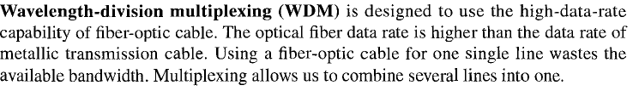
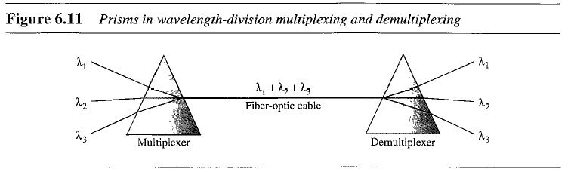
Wavelength Division Multiplexing (WDM)
6.<number>

Slide 15

Figure 6.12 TDM (Synchronous)
6.<number>

Slide 16
Note
TDM is a digital multiplexing technique for combining several low-rate
channels into one high-rate one.
6.<number>

Slide 17

Figure 6.13 Synchronous time-division multiplexing
6.<number>

Slide 18
Example 6.5
In Figure 6.13, the data rate for each input connection is 1 kbps. If 1 bit at a time is multiplexed (a unit is 1 bit), what is the duration of (a) each input slot, (b) each output slot, and (c) each frame?
Solution
We can answer the questions as follows:
a. The data rate of each input connection is 1 kbps. This means that the bit duration is 1/1000 s or 1 ms. The duration of the input time slot is 1 ms (same as bit duration).
6.<number>

Slide 19
Example 6.5 (continued)
b. The duration of each output time slot is one-third of the input time slot. This means that the duration of the output time slot is 1/3 ms.
c. Each frame carries three output time slots. So the duration of a frame is 3 × 1/3 ms, or 1 ms. The duration of a frame is the same as the duration of an input unit.
6.<number>

Slide 20
Example 6.6
Figure 6.14 shows synchronous TDM with a data stream for each input and one data stream for the output. The unit of data is 1 bit. Find (a) the input bit duration, (b) the output bit duration, (c) the output bit rate, and (d) the output frame rate.
Solution
We can answer the questions as follows:
a. The input bit duration is the inverse of the bit rate:
1/1 Mbps = 1 μs.
b. The output bit duration is one-fourth of the input bit duration, or ¼ μs.
6.<number>

Slide 21
Example 6.6 (continued)
c. The output bit rate is the inverse of the output bit duration or 1/(4μs) or 4 Mbps. This can also be deduced from the fact that the output rate is 4 times as fast as any input rate; so the output rate = 4 × 1 Mbps = 4 Mbps.
d. The frame rate is always the same as any input rate. So the frame rate is 1,000,000 frames per second. Because we are sending 4 bits in each frame, we can verify the result of the previous question by multiplying the frame rate by the number of bits per frame.
6.<number>

Slide 22
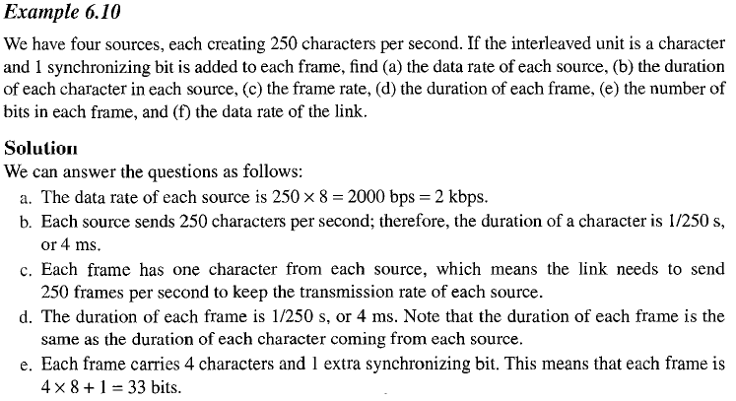
Example 6.10
6.<number>

Slide 23

Figure 6.14 Example 6.6
6.<number>

Slide 24

Figure 6.18 Empty slots
6.<number>

Slide 25

Figure 6.26 TDM slot comparison
6.<number>

Slide 26

Figure 6.19 Multilevel multiplexing
6.<number>

Slide 27

Figure 6.20 Multiple-slot multiplexing
6.<number>

Slide 28

Figure 6.21 Pulse stuffing
6.<number>

Slide 29

Figure 6.22 Framing bits
6.<number>

Slide 30

Figure 6.23 Digital hierarchy
6.<number>

